Slide 2
What is Islam? A Comprehensive System of Thought and Life a new Civilization
Notes:
Key point – Islam is NOT first and foremost a religion. It is a comprehensive political and legal system. This is how it has always been since Muhammad migrated to Medina in 622 AD.
This is the single most important concept that all Americans and Christians in particular need to understand.

Slide 3
Disclaimer
Facts
Not opinions
Official public websites or official documents
Notes:
My goal is to provide facts with citations so that you can continue your own study.
Fortunately, until recently the Islamic community was very open and it was easy to verify what they have said and are saying. Because many in the West are doing solid research many Islamic organizations are pulling this information from their websites.

Slide 4
Research Sources
Works written by Muslims for Muslims
Works written by Muslims for non-Muslims
Works written by non-Muslims for non-Muslims
Works written by former Muslims for non-Muslims
Notes:
As I began my study after 9/11, I quickly realized the need to carefully select what I read. For the most part, I use resources which are written for Muslims by Muslims. The other sources I use only for insight or because they are in the mainstream and I need to know what is being said by the pundit crowd.

Slide 5
9/11 - My Learning Curve
Islam as an unknown
Islam in its own chronological context
Islam through original sources
Quran
Ishaq – biography of Muhammad
Saha sitta – the 6 reliable Hadith authors
al-Misri – Classical Islamic Jurisprudence
Ibn Khaldun – Classical Islamic historian
Notes:
At 9/11 when I began this journey, I knew almost nothing about Islam. I was like most Americans.
I quickly realized that the writings of people like John Esposito and Karen Armstrong needed to be set aside. I also realized that most of what I heard on from the mainstream media and that includes Fox news was suspect at best. The phrase “trust but verify” became my rule as I attempted to decide if what I was hearing or reading was true. This necessity has not changed.
This is my initial list of original sources.

Slide 6
“It is the nature of Islam to dominate, not to be dominated, to impose its law on all nations and to extend its power to the entire planet.”
Hasan al-Banna
Founder of the Muslim Brotherhood
Notes:
This statement is accepted truth by any Muslim who is serious about his belief because it is a summary of the Muhammad’s exhortations and Muhammad is the perfect example for all Muslims.
Muslims really believe this and are acting accordingly.
What I trust you will leave with today is more than an understanding but rather an appreciation of the fact the Muslims are organized, have a creed, principles, stated objectives and a plan.
The plan in the US is to destroy democracy by using democracy and ultimately replace the Constitution and Christianity with Islamic Law and Islam as the sole religion of the Land.

Slide 7
Notes:
One of 2 churches burned in December 2011 in Zanzibar

Slide 9
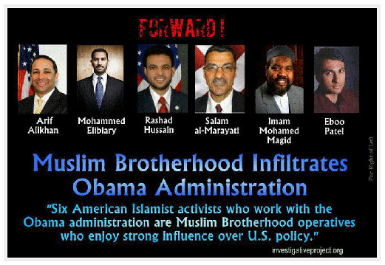
Muslim Brotherhood Federal Appointees

Slide 10
Proverb
Me against my brother
Me and my brother against my family
Me and my family against the clan
Me and my clan against the tribe
Me and my tribe against the nation
Me and my sect against the hypocrite and the apostate
Me and the ummah against America, Israel, the West and all the infidels
Notes:
When dealing with people from non-western societies, we need to understand how allegiance and loyalty operates. We in the west and in particular those of us with a Judeo-Christian worldview do not subscribe to this framework. It is not wise nor appropriate to just say this is wrong just because we do not believe this or operate as though this is truth.
We must understand this if we are to engage Muslims successfully.

Slide 11
Key Concepts
Islam is a comprehensive system of thought and life, an ideology, a new civilization, NOT primarily a religion
Sharia Law is foreign law
Dualism dominates every conversation
Dialogue with Muslims is one way
There is no common ground in spite of the use of common terms…
Notes:
I will repeat these key concepts often mainly as a means to replace myth with a factual frame of reference. We must know our enemies and understand their foundational principles because they determine their agenda and objectives.
We need to understand that Islamic Law provides very specific instructions for a Muslim in terms of how he/she must deceive a non-Muslim..
We need to believe that the rules of conversation we as Christians adhere to are not the same as the rules prescribed for a Muslim.
Dualism: All of Western logic is based upon the law of contradiction--if two things contradict, then at least one of them is false. But Islamic logic is dualistic; two things can contradict each other and both are true. More later on this issue.
Dialogue: Let me share a perspective that I learned from David Hosaflook. Always reason from the Scriptures, let the Scriptures speak for themselves and continually come back to the phrase “Let me tell you about my Jesus.” There is no wisdom in debate or dialogue when talking to a Muslm.

Slide 12
Dualistic Ethics or Dualism
No Golden Rule – two sets of ethical rules
12 Verses—Muslims not to be a friend of a Kafir
Integrity can not be defined
Taqiyya — sacred deceit
Notes:
Why is this so? Allah divides all of humanity into 2 groups – believers (all Muslims) and kafirs. For Muslims, based on the example of life of Muhammad, there are 2 sets of rules. One set for how Muslims are to treat other Muslims and one set for how Muslims are to treat non-Muslims.
For example, Muslim charities may only distribute to or aid other Muslims.
This is because there are 2 Muhammads. The Meccan and the Medinan Muhammad.

Slide 13
Dualism applied
Is Islam a religion of peace?
Is there compulsion of religion?
Is Islam a violent religion?
Answers: yes and no, it depends on the answer to these questions:
For whom?
Under what circumstances?
Notes:
Yes if you are a Muslim who is faithfully adhering to the tenets of Islam or obeying the Sharia.
No if you are a hypocrite, apostate or infidel

Slide 14
Is Islam an Abrahamic Religion?
What are the Abrahamic Religions:
Judaism
Christianity
Islam
Answer: Yes and No
Notes:
Yes in the sense that all three religions look back to Abraham as the father of the religion. However, while they all hearken back to Abraham, that is the extent of the connection.
Judaism and Christianity relate back to Abraham through Isaac and Islam through Ishmael.
Fundamentally, aside from the common use of names, there is no similarity between Islam and Christianity.

Slide 15
Relative Terms of Reference
Radical – relative to what or whom
Extremist – relative to what or whom
Moderate – relative to what or whom
Reformed – relative to what or whom
Notes:
Complicating this myth are the terms being used. Every one of these terms are relative. What we need to understand is that everyone of us is a radical, extremist, moderate and reformed, depending on the perspective of others.
These terms only confuse the discussion, perhaps deliberately.

Slide 16
Extremist/Radical/Fundamentalist or Moderate?
Islam
Christianity
Infidel = secularists
Apostate
Hypocrite
Fundamentalist or Extremist or Radical
Secular
Liberal
Conservative/Evangelical
Fundamentalist
What is a fundamentalist?
The Taliban and Al Qaeda are the REAL Muslims if the assessment is based on settled Islamic jurisprudence and history.
Notes:
In Islam, the world is divided into 4 groups. Believers or Fundamentalists, Hypocrites, Apostates and Infidels. In Christianity we have two groups – believers and unbelievers.
What is common to both groups is the “– in name only” issue or those who are either cultural Muslims or cultural Christians. The “– in name only” group are also best described as the so-called moderates or secular or cultural be they Muslims or Christians.
Fundamentalist = a person who knows what they believe, why they believe and are willing to act based on their belief which is what a jihadist does. This applies to Islam as well as to Christianity.
Thinking back to the 45 Million Muslims, this includes not just the fighters. It includes those providing financial support, logistical support, ideological support, etc.

Slide 17
Islam Defined
Islam is not just a religion, but a “complete way of life governed by Islamic Law (Shari’ah).”
Islam is a political, economic, military, social, cultural, family, and religious system. In Islam, theology is subordinate to the requirement to adhere to the Shari’ah.
Notes:
As we consider Islam, the first issue we must address is the misnomer that Islam is first and foremost a religion as we in the West traditionally define a religion. Islam is better defined as a comprehensive system or a worldview. We Christians debate points of doctrine, Muslims debate points of Islamic Law.
You will hear me repeat this over and over again.
Thus, we are not dealing with freedom of religion or a First Amendment right but rather with Rule of Law or Article 6 of the Constitution issue. Thus because for a Muslim, Islamic Law is the Law of the Land, Muslims should not expect to enjoy the benefits of the 1st Amendment.

Slide 18
What then is Islam?
Islam is a geo-political ideology and a replacement religion and civilization
Islam the religion is what a Muslim does to go to Paradise
Islam the political, economic, military and social system determines the treatment of unbelievers, hypocrites and apostates – the kafirs
Islam is governed by Islamic Jurisprudence or Sharia Law, not Theology
Notes:
The division between church and state does not exist in Islam.
Islam is a land-based religion. Once a parcel of land has been conquered by Islam, the land eternally belongs to Islam. The world is thus divided into the dar al Islam and dar al harb, or the land of submission and the land of war. Infidels or unbelievers rule in the dar al harb. Thus the US is the land of war because the Law of the Land in the US is not Sharia.
Islam is a political system. The “undisputed rule of Islam” or Sharia Law is intended to be universal.
Islam is a replacement religion. Every major event in the Old Testament and New Testament to include God’s covenants with man is either replaced entirely or are substantially redefined in Islamic writings. Ishmael replaces Isaac, Jesus the God-man is replaced with Jesus the man, the Bible is replaced with the Quran, etc.
Islam is a religion of law not theology. That is, it is a religion of works not grace.

Slide 19
Definitions – the system
Islam – literally = submission to Allah or slave of Allah
Muslim – a person who submits to Allah
Ummah – worldwide community of Muslims
Caliph – title for the leader of the Islamic Ummah
Ulema – Muslim scholars trained in Islamic Law
Notes:
This an initial list of key words. It is important to use these terms accurately when talking to a Muslim.

Slide 20
Definitions - sources of authority
Quran – the final divine guidance and moral direction for mankind which is unalterable
Sira – example of Muhammad – his biography
Hadith – words and deeds of Muhammad
NOTE: The Sira and the Hadith together are the Sunnah
Notes:
This trilogy of texts carefully codifies how a Muslim lives. It provides excruciating details about such things as which shoe to put on and take off first. Because for a Muslim life is all about mirroring the example set by Muhammad.

Slide 21
Islamic Fundamentals Corpus Juris of Islamic Law
Qur’an – direct uncreated revelation
Tafsīr – commentary on the Quran
Sīrah Rasūl Allāh – usual habits and practices of Muhammad or the biography of the Messenger
Hadith – narration on the words and deeds
Shari’ah jurisprudence – law of all Islamic lands
Shari’ah policy – government in accordance with the goals and objectives of Shari’ah and in its widest sense applies to all government policies
Notes:
Are these our founding documents?
Next we are going to walk through the Quran in greater detail, explain how to use it and then look at the Haddith and finally a look at Sharia Law with an emphasis on it as the Law of the Land.

Slide 22
The Periods of Quranic Revelation
Middle Meccan 18% (21)
Late Meccan 18% (21)
Medinan 21% (24)
Early Meccan 42% (48)
Notes:
The surah or chapters of the Quran record a pattern of transition. Unfortunately, however, when we open a Quran, we find an anthology that is not compiled chronologically. Rather it is compiled based on length of the surah.
If read chronologically, the transition from peaceful coexistence to political violence becomes clear. There is also an attitude change regarding how Muslims are to treat the infidels (Christians, Jews and others).
Terms like jihad gain clear boundaries, applications and unambiguous definitions. This is not understood until one reads the Quran in a chronological manner. The clarity increases further when one reads the sunnah and the hadith.
The Early Meccan surahs are very peaceful. The later Medinan surahs are full of violence and these abrogate the earlier passages.

Slide 23
The Islamic “Bible”
Islam is 14% Allah and 86% Mohammed

Slide 24
Amount of Text Devoted to Kafir Kafir = non-muslim
Notes:
Who are the kafir?
People of the Book = “Christians” who believe in Allah, the last Prophet, and deny the trinity, the incarnation and the crucifixion of Christ and that Christ will return to establish Shari'a Law. “Jews” who believe the Torah is corrupt and that Muhammad is the last in the line of Jewish prophets.
Dhimmi – a non-Muslim who willingly submits to the dictates of Islam and refuses to say or do anything that is critical of Allah, Muhammad or the Quran and offends a Muslim. Political Correctness or Islamophobia.

Slide 25
Definitions - sects
Sunni Islam:
Largest sect (80-90%),
Leadership succession is a function of elected community consensus – Muftis and Mullahs
Shia Islam:
Leadership succession as a matter of direct family lineage to Muhammad – Imams & Ayatollahs
Anticipates the return of the Mahdi
Sufi Islam – mystics
Salafi Islam – adherants to the earliest fundamentals
Notes:
A word of caution here. Muslims like to divert the conversation or allow the conversation to divert to a sectarian discussion because this takes the focus off that which is settled among ALL of the sects, which is 85-95% of revealed truth in Islam. There is no disagreement about the relationship of Muslims to non-Muslims.
The sect debate is the internecine debate or the squabble among Muslims. Try to keep the discussion on what the Quran itself says and what is settled hadith.
Let the Muslims debate the sects issues among themselves.

Slide 26
Definitions – schools of law
Sunni Schools of Law
Hanafi
Hanbal
Malik
Shafi’I
Shia Schools of Law
Usuli
Akhbari
Shayki
Notes:
Within Islam, there are 7 primary schools of Islamic Law. Among these schools consensus exists at the 85-95% level. The importance of this reality will become clearer as we move along.
The major differences between the Sunni and Shia relate to succession within Islam and the expected return of the Mahdi as well as a few practice issues. Do not attempt to get in the middle of this debate. Jesus was able to divide the Sadducees and Pharisees, we are not quite that wise.

Slide 27
Sunni Islam
Hanafism
Malikism
Shafism
Hanbalism
622 AD
Takfirism
Circa 750 AD
Wahhabism
Circa 1300 AD
Ibn Taymiyya (Takfiri)
Circa 1750 AD
Abd al-Wahhab

Slide 28
Definitions – the legal structure
Sharia – derived from the Quran and Sunnah
Fiqh – legal understandings which extend the Shariah
Fatwa – legal opinions or the means to implement the Sharia
Ijma – consensus of the scholars
Ijtihad – process of legal reasoning
Dawah – inviting unbelievers to Islam
Notes:
Dawah is a rough equivalent to evangelism in Christianity.

Slide 29
Naskh or Abrogation
There is, no naskh after the demise of the Prophet. But during his lifetime, there were instances when some of the rulings of the Qur’an and Sunnah were either totally or partially repealed by subsequent rulings. This was due mainly to the change in circumstances in the life of the community and the fact that revelations of the Qur’an spanned a period of twenty three years.
Muhammad Hashim Kamali, Principles of Islamic Jurisprudence
The law was laid down in the period of the Prophet (peace be unto him) gradually and in stages. The aim was to bring a society steeped in immorality to observe the highest standards of morality. This could not be done abruptly. It was done in stages, and doing so necessitated repeal and abrogation of certain laws.
Imran Ahsan Khan Nyazee, Islamic Jurisprudence
Notes:
Abrogation is principle used to accurately understand Islam as it codifies the level of authority of each surah or chapter.
Dr Kamali served as the Chairman of the Constitutional Review Commission of Afghanistan in 2003, was trained in Islamic Law at the Univ of Kabul. He then served as an Assoc. Prof and subsequently as a Public Prosecutor with the Ministry of Justice, Afghanistan. Currently he is the CEO and Chairman of the International Institute of Advanced Islamic Studies, Malaysia.
Dr . Nyazee is currently in charge of training and publications at the Shari’ah Academy, a unit of the International Islamic University, Islamabad, Pakistan.
Sharia Law is real law and it is foreign law in the US.

Slide 30
Scholarly Consensus (ijma’)
Scholarly consensus (ijma’) is the agreement of all mujtahids of the Muslims existing at one particular period after the Prophet’s death about a particular ruling regarding a matter or event.
When the four necessary integrals of consensus exists, the ruling agreed upon is an authoritative part of Sacred Law that is obligatory to obey and not lawful to disobey. Nor can mujtahids of a succeeding era make the thing an object of new ijtihad, because the ruling on it, verified by scholarly consensus, is an absolute legal ruling which does not admit of being contravened or annulled.
Al-Misri, Book B, “The Validity of Following Qualified Scholarship," at b7, 1-2.
Notes:
Al-misri’s text, Reliance of the Traveler, was published circa 1350 AD. The age and reliability of this text is important when discussing the historicity of consensus within Islam.
A Mujtahid is an Islamic legal authority
In Sunni Islam in particular, only a legitimate mujtahid may issue a legal decision. Knowing this helps to knock down the argument that there are many versions of Islam. This is another deliberate distraction.
Note the specific requirements and the consequences of a ruling in Islamic Law.
This principle of consensus is critical to addressing the myth that there are many versions of Islam. There is only one version of Islam. Do not let the Shia/Sunni divide confuse you. More on this in a few minutes. Islamic Law is Islamic Law.

Slide 31
Scholarly Consensus - Today
o9.3 Jihad is also personally obligatory for everyone able to perform it, male or female, old or young when the enemy has surrounded the Muslims on every side, having entered our territory, even if the land consists of ruins, wilderness, or mountains, for non-Muslim forces entering Muslim lands is a weighty matter that cannot be ignored, but must be met with effort and struggle to repel them by every possible means.
Umdat al Salik, Book O “Justice,” § 9 “Jihad”
All the schools of Islamic jurisprudence - the Sunni, the Shiite… and all the ancient and modern schools of jurisprudence - agree that any invader, who occupies even an inch of land of the Muslims, must face resistance. The Muslims of that country must carry out the resistance, and the rest of the Muslims must help them. If the people of that country are incapable or reluctant, we must fight to defend the land of Islam, even if the local Muslims give it up.
Yusuf Qaradawi, Qatar TV Sermon, February 25, 2006
Notes:
The first citation is from 1350 AD, the second in from 2006. Note the consistency of argument and how jihad is defined.
Qaradawi’s sermon is available at the MEMRI website.
During one of his widely viewed Qatar TV sermons on February 25, 2006, Qaradawi elucidated <http://www.memritv.org/Transcript.asp?P1=1052> these ideas:

Slide 32
Suras of the Qur’an in Chronological Order
Let there be no compulsion in religion: Truth stands out clear from error: whoever rejects evil and believes in Allah hath grasped the most trustworthy handhold
(Qur’an 2:256)
BUT
Whoever seeks a religion other than Islam will never have it accepted of him, and he will be of those who have truly failed in the hereafter (Qur’an 3:85)
Resulting In
Oh ye who believe! Take not the Jews and the Christians for your friends and protectors; they are but friends and protectors to each other. And he amongst you that turns to them for friendship is of them. Verily Allah guideth not the unjust. (Qur’an 5:51)
Notes:
This is a listing of the surahs or chapters in chronological order. Every scholar of Islam knows this sequence and knows why each sura is where it is in the sequence.
Using the popular accolade that Islam is a religion of peace, let’s follow the order and sequence and see where we end up.
Click through…
So I must ask: Is Islam a religion of peace?? If so, when and for whom?
Notice how MAJ Hasan handles this and this is from his brief that he gave at Walter Reed multiple times before he went to Forty Hood.

Slide 33
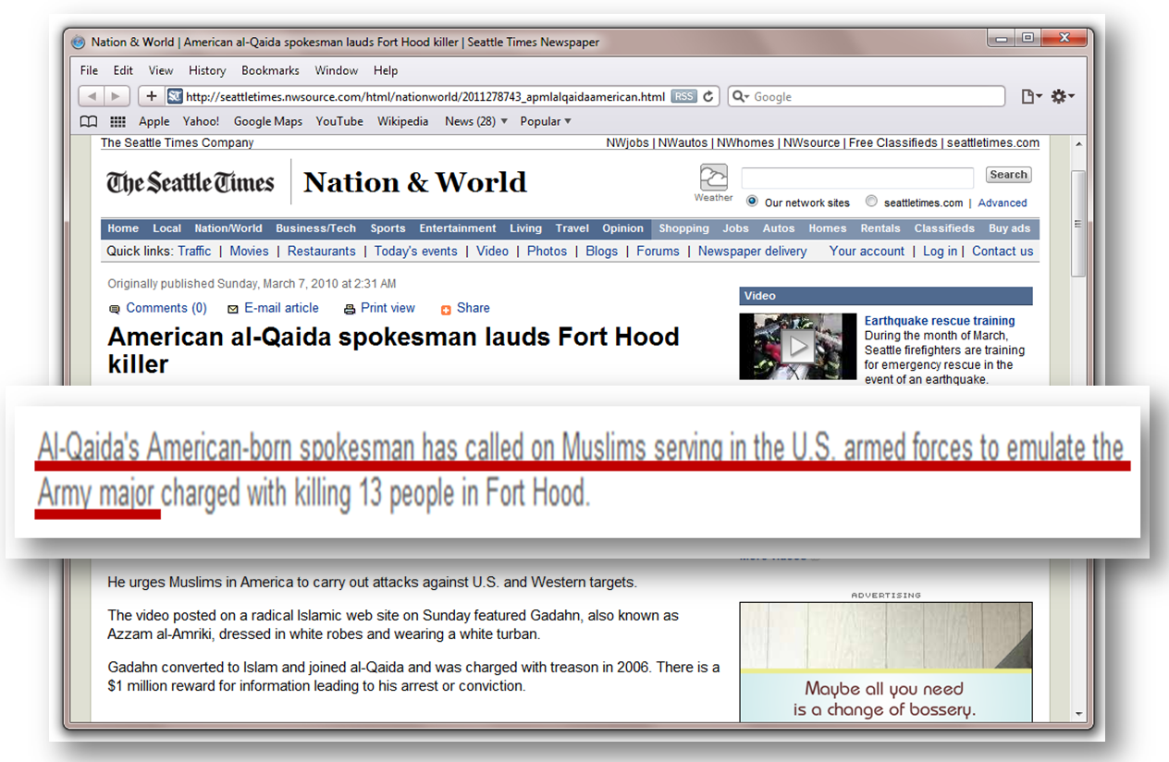
Suras of the Qur’an in Chronological Order
Results in This
Fight and slay the unbelievers wherever ye find them, and lie in wait for them in every stratagem of war. But if they repent, and establish regular prayers and practice regular charity, then open the way for them; for Allah is Oft-forgiving, Most Merciful.
(Qur’an 9:5)
This
Whoever seeks a religion other than Islam will never have it accepted of him, and he will be of those who have truly failed in the hereafter
(Qur’an 3:85)
And This
Fight those who believe not in Allah nor the Last Day, nor hold that forbidden which hath been forbidden by Allah and His Apostle, nor acknowledge the religion of truth, even if they are of the people of the Book, until they pay the jizya with willing submission, and feel themselves subdued. (Qur’an 9:29)
Notes:
One more illustration. This time to gain an understanding of what jihad is.
What have we learned?
First we now understand who is “cherry picking” from the Quran.
Second we learn that there are some fairly simple rules of exegesis and hermeneutics which we can apply.

Slide 34
Iraqi & Afghan Constitutions Refer to It!
Iraq
Section One, Article 2:
First: Islam is the official religion of the State and it is a basic source of legislation:
No law can be passed that contradicts the undisputed rules of Islam
No law can be passed that contradicts the principles of democracy
No law can be passed that contradicts the rights and basic freedoms outlined in this constitution
Afghanistan
Article 2 [Religions].
(1) The religion of the state of the Islamic Republic of Afghanistan is the sacred religion of Islam
Article 3 [Law and Religion].
In Afghanistan, no law can be contrary to the beliefs and provisions of the sacred religion of Islam
Doesn’t this mean
al-Qaeda’s long-term objectives were met to the exclusion of U.S. objectives in Constitutions WE drafted?
Notes:
Article 2:
First: Islam is the official religion of the State and it is a fundamental source of legislation:
No law that contradicts the established provisions of Islam may be established.
No law that contradicts the principles of democracy may be established.
C. No law that contradicts the rights and basic freedoms stipulated in this constitution may be established.

Slide 35
Arab Constitutions & Islamic Law
Article 3 [Islam] Section 2 of the Syrian Constitution
Islamic jurisprudence is a main source of legislation.
Chapter 1 Articles 2 & 106 of the Jordanian Constitution
Islam is the religion of the State and Arabic is its official language.
The Shari’a Courts shall in the exercise of their jurisdiction apply the provisions of the Shari’a law.
Chapter 1, Article 7 of the Saudi Constitution
Government in Saudi Arabia derives power from the Holy Quran and the Prophet's tradition
Part 1, Article 2 of the Egyptian Constitution
Islamic jurisprudence is the principal source of legislation.
Notes:
Does this sound like US Law?

Slide 36
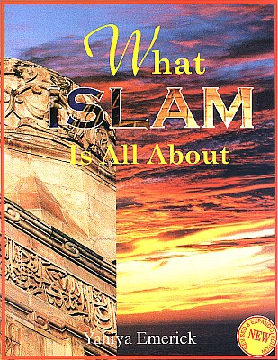
What Islam is All About?
It really is not complicated – even 7th Graders can understand it.
Notes:
Once again, this is being used to teach 7th graders in Islamic Schools in the US.

Slide 37
What is Taught to Muslim Americans in Junior High
What Islam is All About
By Yahiya Emerick
American-born convert to Islam
Widely regarded as a “leading Islamic children’s educationalist in the US
Is the best selling English language Islamic school text for junior high level students in the United States since its initial publication back in 1997
Also wrote The Complete Idiot’s Guide to Understanding Islam
An interesting comparison
Current version the Fifth Revised Printing - June 2004
This is what Muslim 7th graders are taught at the
Mosque and Islamic School in America today!
Notes:
The Complete Idiot’s Guide to Understanding Islam is an example of deliberate deception, similar to the text prescribed for the UNC students.

Slide 38
Elements of Islam
Islam is not just a religion but rather a complete way of life governed by Islamic law which comes from Allah who alone is Sovereign.
Not just a religion but a complete way of life
According to the Qur’an, Islam is the way of life Allah instituted for humanity, even as the rest of the universe submits to His will. (41:11). (Emerick, 50)
Governed by Islamic law
There is no disagreement among the scholars of the Muslims that the source of legal rulings for all acts of those who are morally responsible is Allah Most Glorious. (al-Misri a1.1)
Notes:
If this can be taught to 7th Graders, why don’t leaders in the US Government understand this?

Slide 39
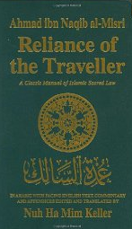
Sacred Islamic Law: The ‘Umdat al-Salik
Notes:
I referred to this text earlier. In terms of understanding Islam it is the first place I go when I begin to study a concept.
When beginning a study about Islam, it is very important to use texts which are written by Muslims for Muslims.

Slide 40
Muslim Brotherhood
Objective in the U.S.
“The Ikhwan must understand that their work in America is a kind of grand jihad in eliminating and destroying the Western Civilization from within and ‘sabotaging’ its miserable house by their hands and the hands of the believers so that it is eliminated and God’s religion is made victorious over all other religions”
Notes:
This is a direct quote from a Muslim Brotherhood document.
This May 1991 memo was written by Mohamed Akram, a.k.a. Mohamed Adlouni, for the Shura Council of the Muslim Brotherhood. In the introductory letter, Akram referenced a "long-term plan…approved and adopted" by the Shura Council in 1987 and proposed this memo as a supplement to that plan and requested that the memo be added to the agenda for an upcoming Council meeting. Appended to the document is a list of all Muslim Brotherhood organizations in North America as of 1991.
This is one of the documents introduced into evidence in the Holy Land Foundation Trial which we will look at in a few minutes.

Slide 41
The United States
The People (All, equally)
Power flow
The Constitution
Executive
Judicial
Legislative
Government
Religious entities, business, clubs, groups, etc
Notes:
Note the stark differences

Slide 42
Global Islamic State
Shari’ah
Executive
Judicial
Government
Legislative
The People (Men)
Power flow
The People (Women)
Large gap
kafirs, dhimmis & other non-Muslims
Notes:
Take a good look at this. Does this look like what we have here in the US? This is the structure prescribed by Sharia.
Here is why this necessary from an Islamic perspective. For a Muslim to swear allegiance to a legal system, a constitution, a nation, other than Allah, the Quran, the last prophet, Muhammad and the Sharia is to do what Allah has prohibited. Thus the Muslim is worthy of death and eternal damnation to hell, unless he is doing so to deceive the non-Muslim (you and me) and to further Islam and the imposition of Sharia, to replace the civilization and in the case of America, to replace all religions and the Constitution.

